Slide 1
UI PROJECT DEVELOPMENT PROJECT NAME :Grocery Mart
TECHNOLOGIES : HTML , CSS and media Quaries,Boostrap and java script

Slide 2
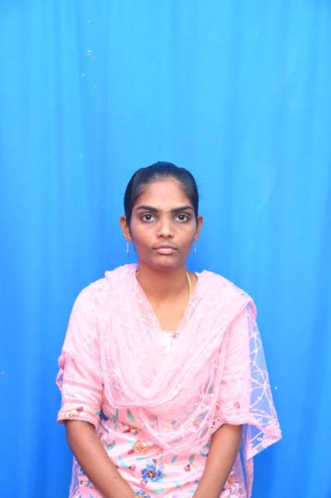


Presented by : Team1
Organization : Anarghya Communications

Slide 3
TECHNOLOGIES WE LEARNT
HTML5(Hyper Text Markup Language).
CSS3(Cascading Style Sheets).
Media Queries.
Bootstrap.
Java script.

Slide 4
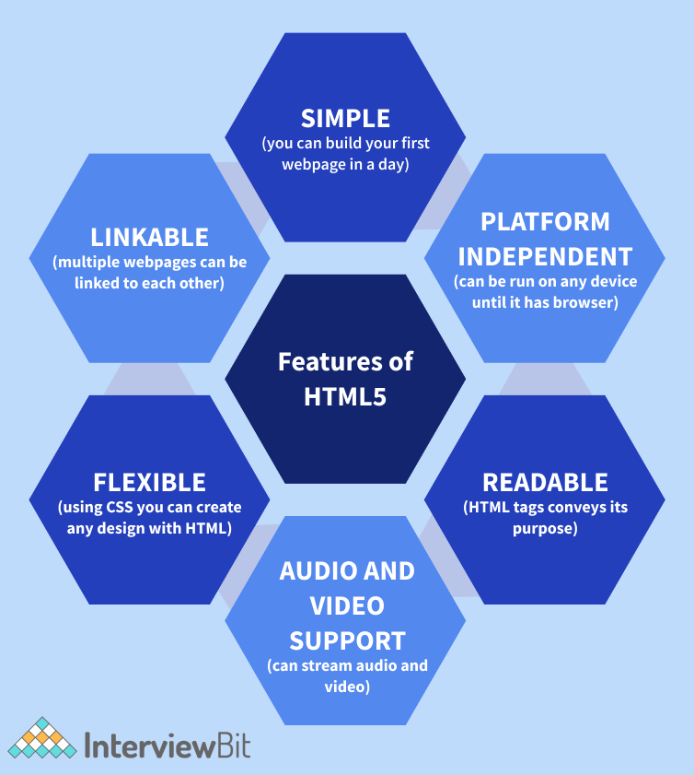
HTML5 uses and applications:
HTML5 is a markup language used for structuring and presenting content on the World Wide Web. It is the fifth and final major HTML version that is a World Wide Web Consortium (W3C) recommendation
HTML5 features include markup and scripting elements, as well as application programming interfaces (APIs) for functionalities such as adding video and audio on a page, local data storage, offline operations, and location data usage

Slide 5
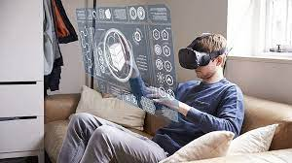
CASCADING STYLE SHEETS(CSS3)
CSS3 provides a consistent and precise positioning of navigable elements.
It is easy to customize a web page as it can be done by merely altering a modular file.
Graphics are more accessible in CSS3, thus making it easy to make the site appealing.
It permits online videos to be seen without using third-party plugins.
CSS3 is economical and time-saving, and most browsers support it.

Slide 6

Bootstrap uses and applications:
Bootstrap is a free front-end framework, with the purpose to make web development faster and easier.
It also includes HTML and CSS-based design templates for forms, typography, buttons, navigation, tables, modals, image carousels, and many other components along with other optional JavaScript plugins.
Bootstrap also provides the users with the ability to easily create responsive designs.
The responsive CSS of Bootstrap also adjusts to phones, tablets, and desktops easily.

Slide 7

Java script uses and applications:
Client-side validation.
Displaying date and time.
To validate the user input before submission of the form.
Open and close new windows.
To display dialog boxes and pop-up windows.
To change the appearance of HTML documents.
To create the forms that respond to user input without accessing the server.

Slide 8

Programs on HTML and CSS 1.Home page 2.Register page 3.Login page 4.product page 5.offer page 6.contact page

Slide 9
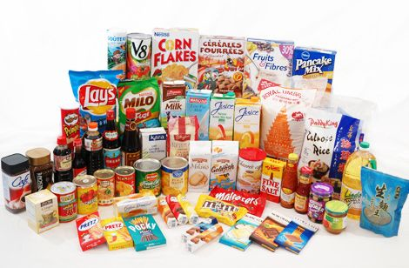
Home Page Code & Output:

Slide 10
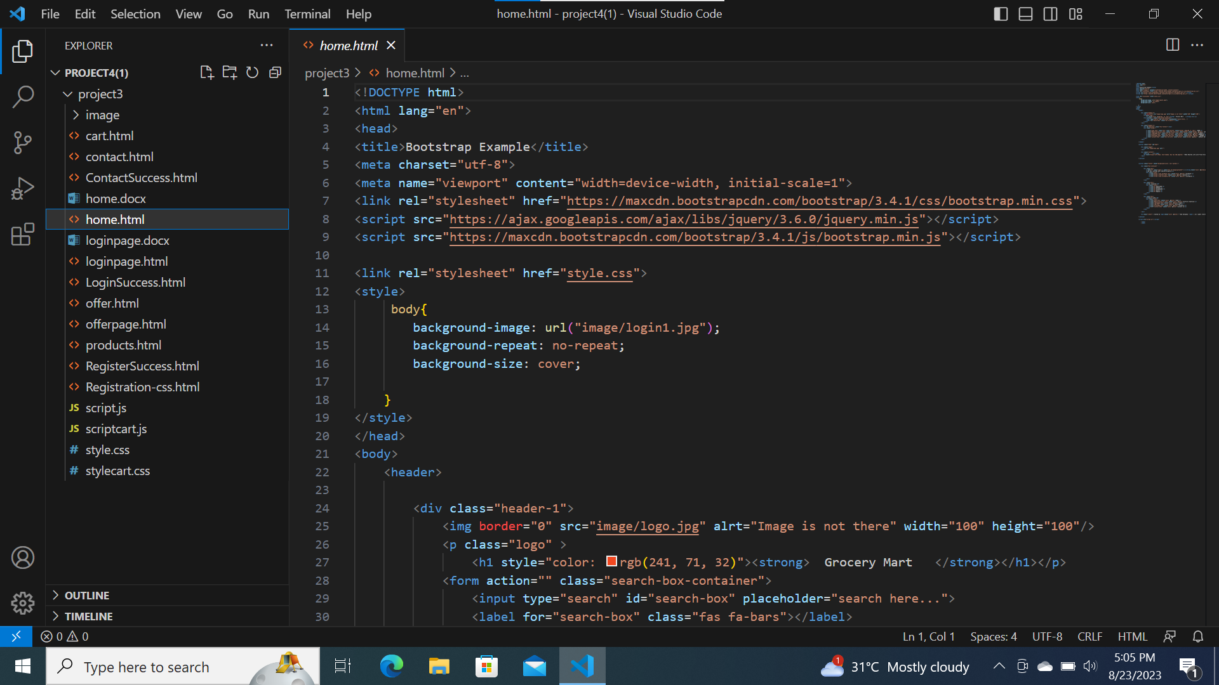

Slide 11
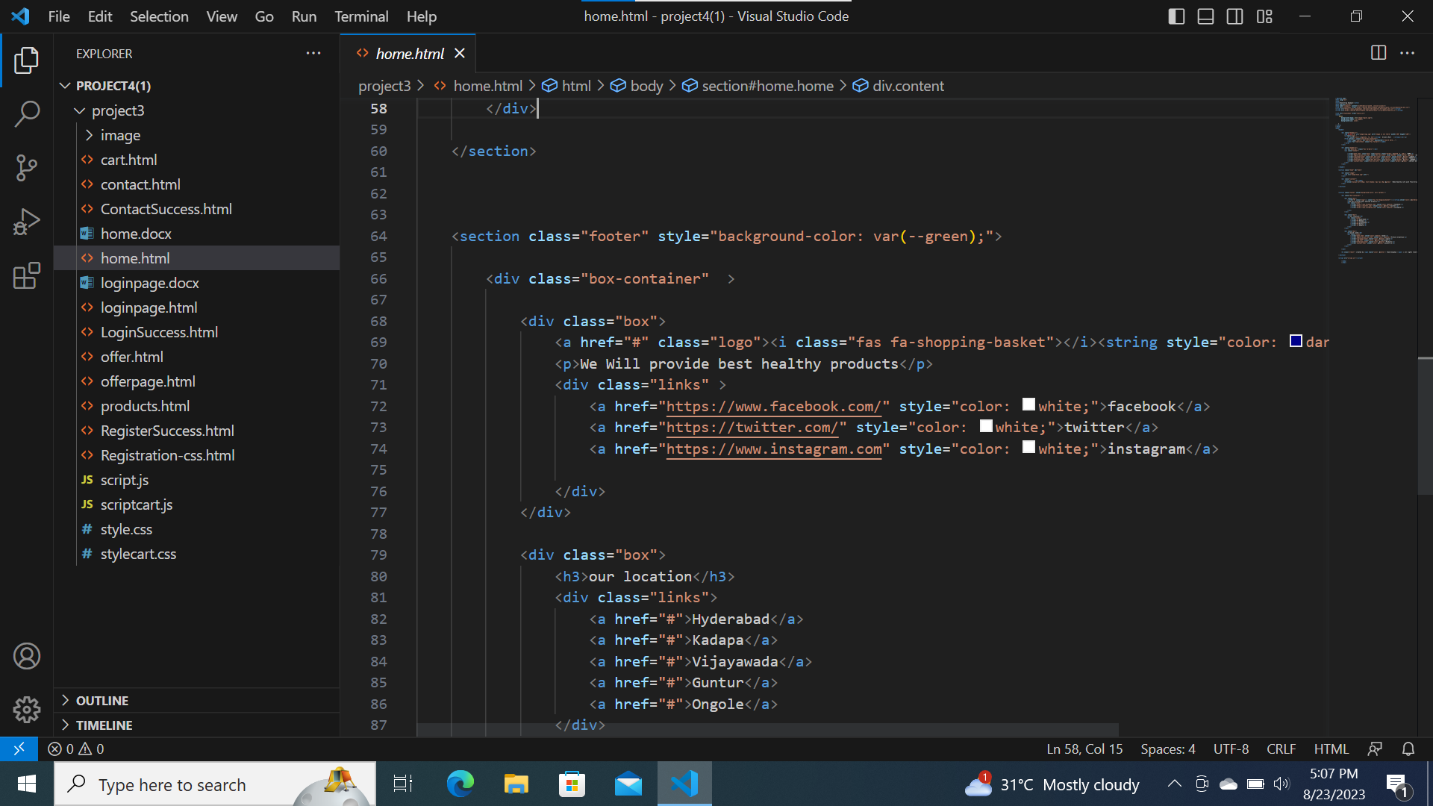

Slide 12
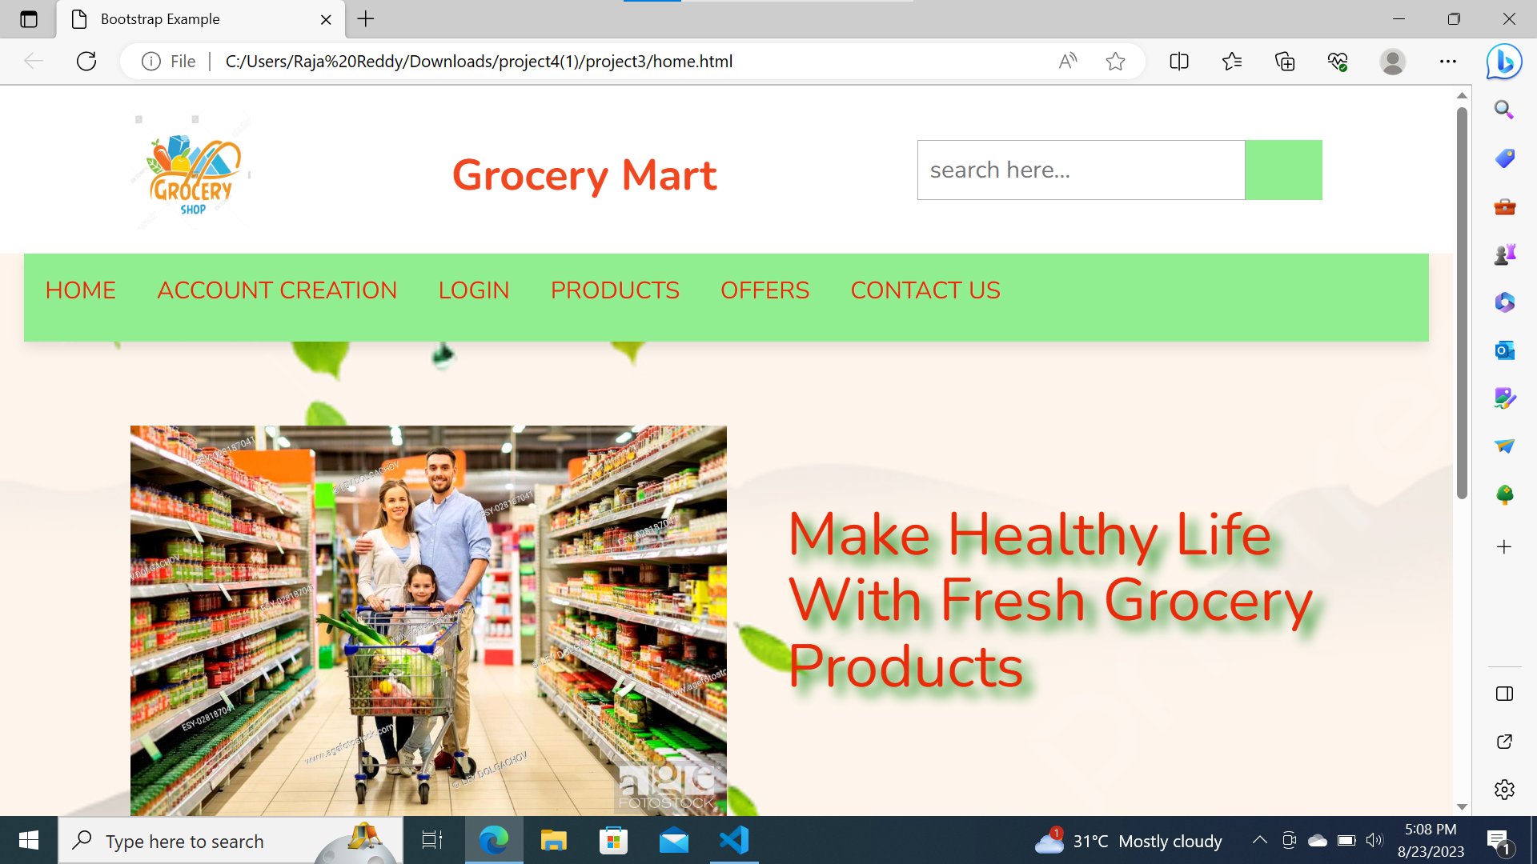

Slide 13
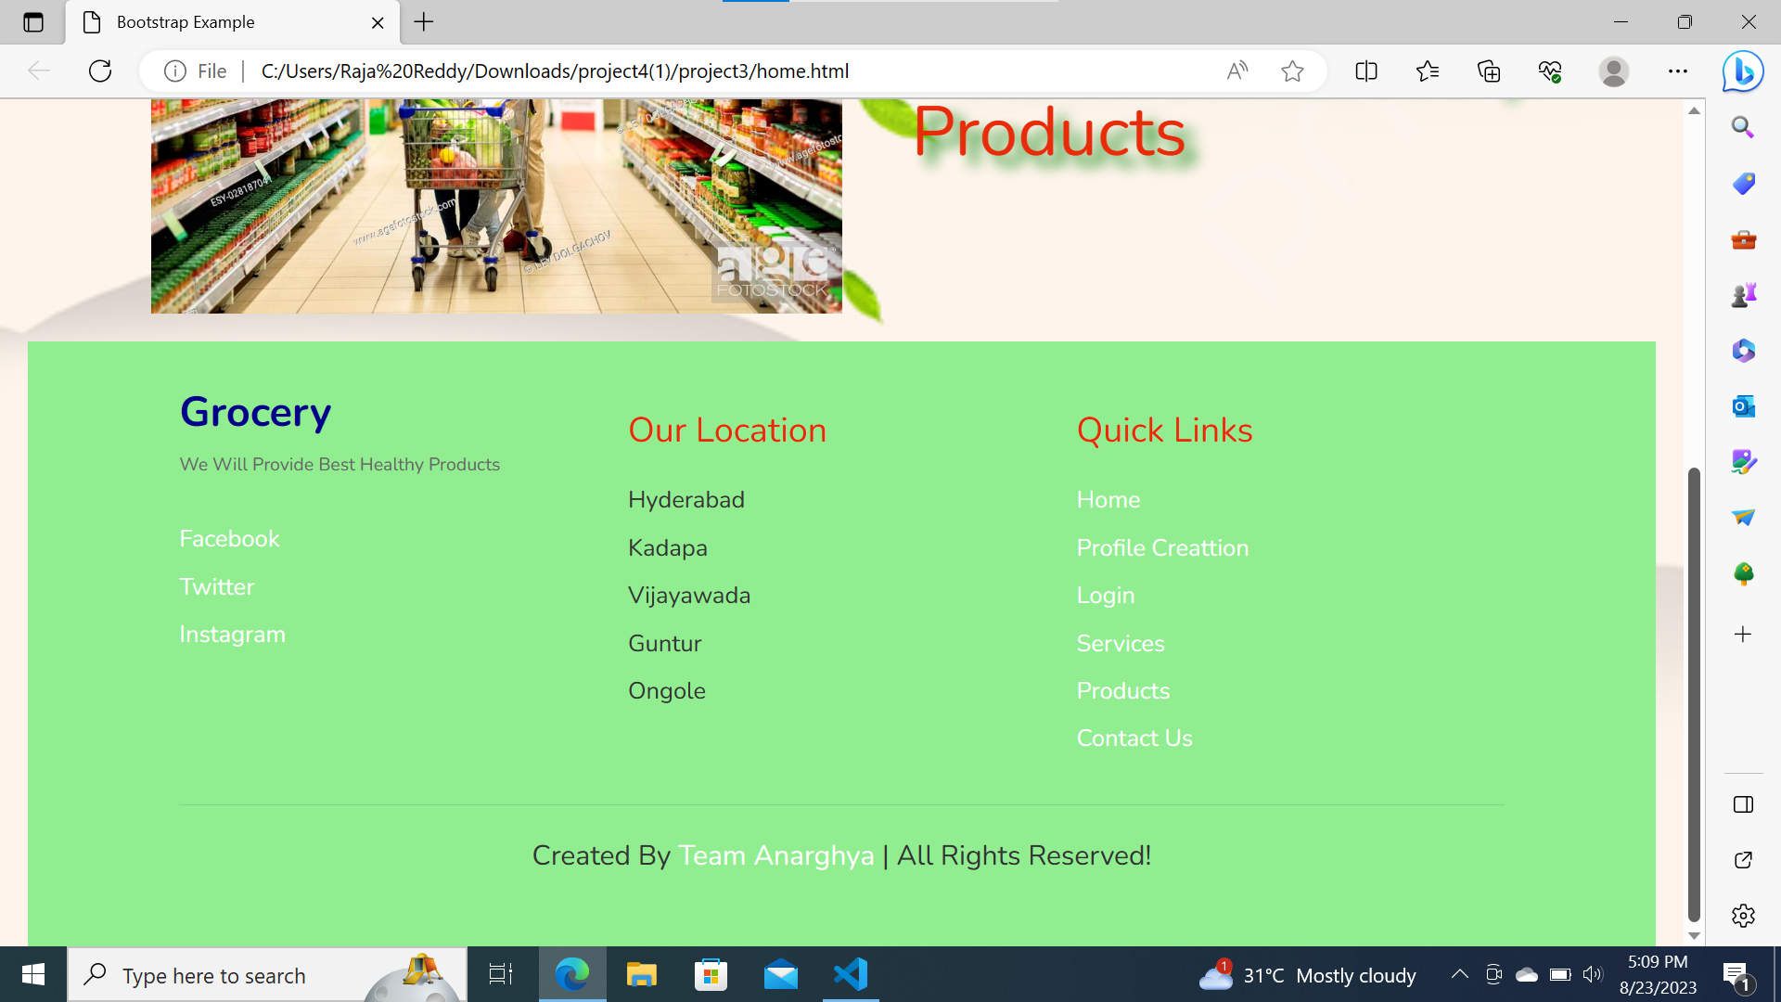

Slide 14

register page code & output

Slide 15
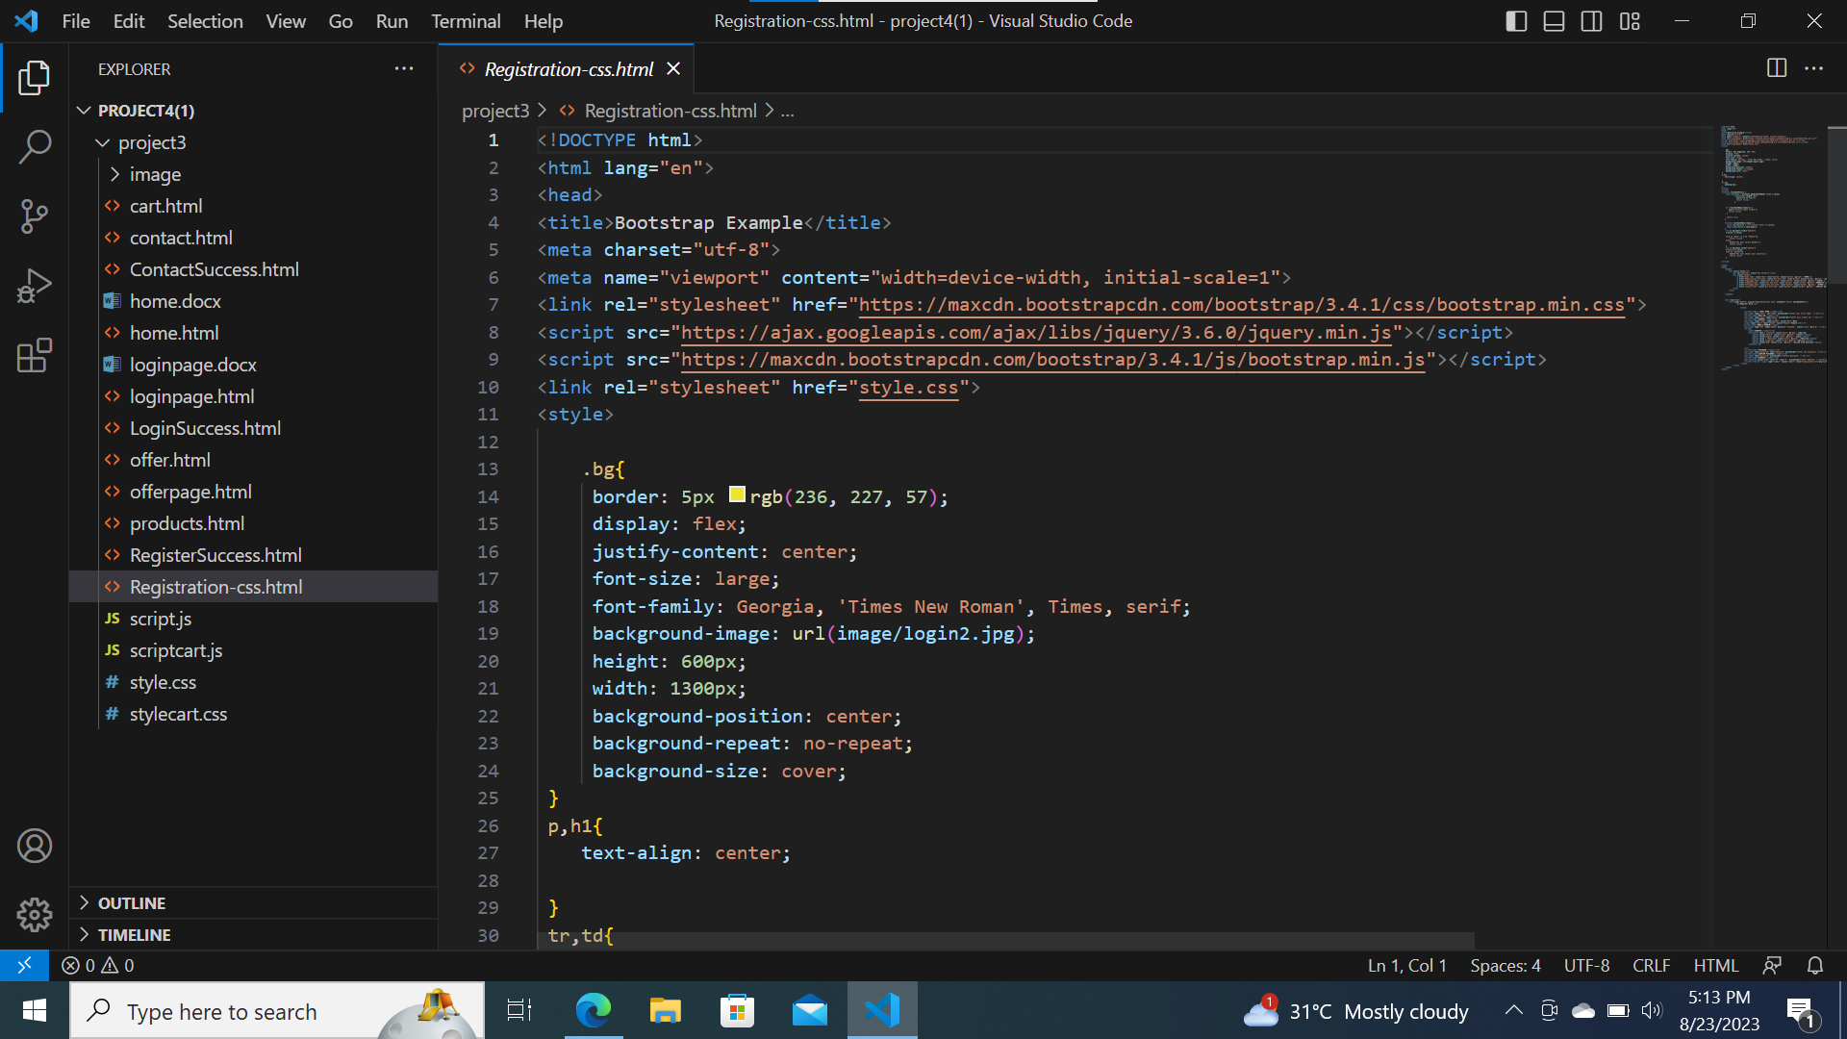

Slide 16
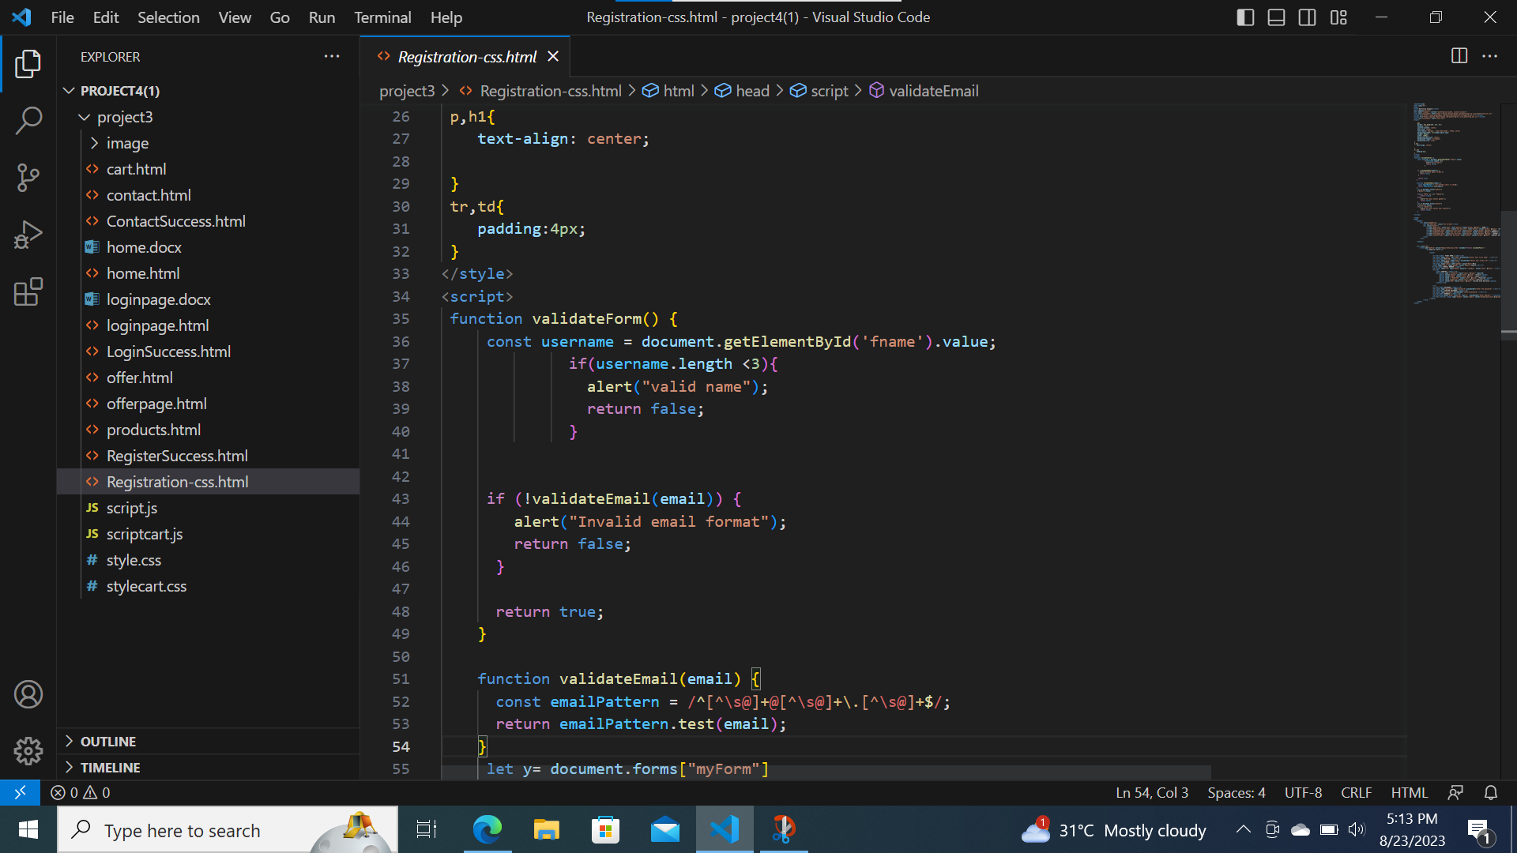

Slide 17
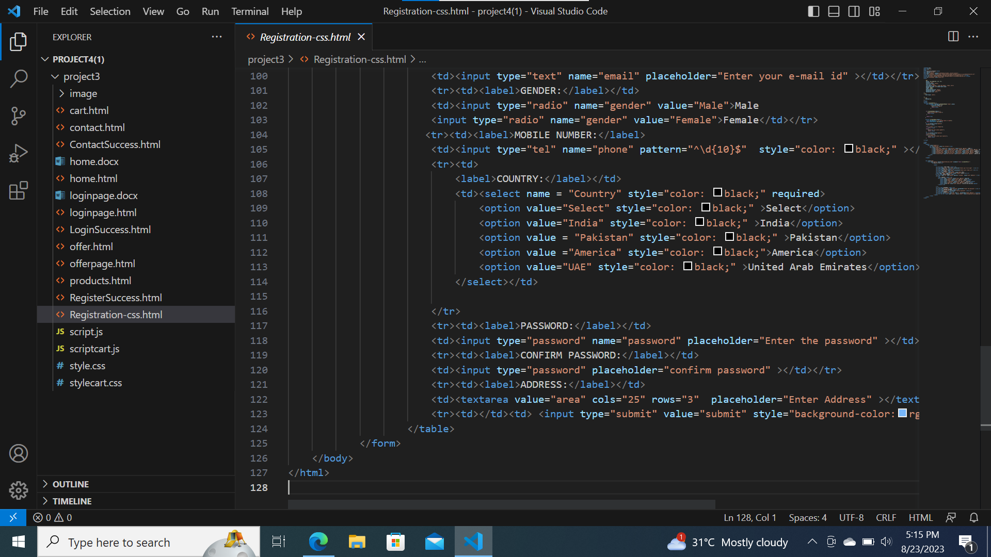

Slide 18
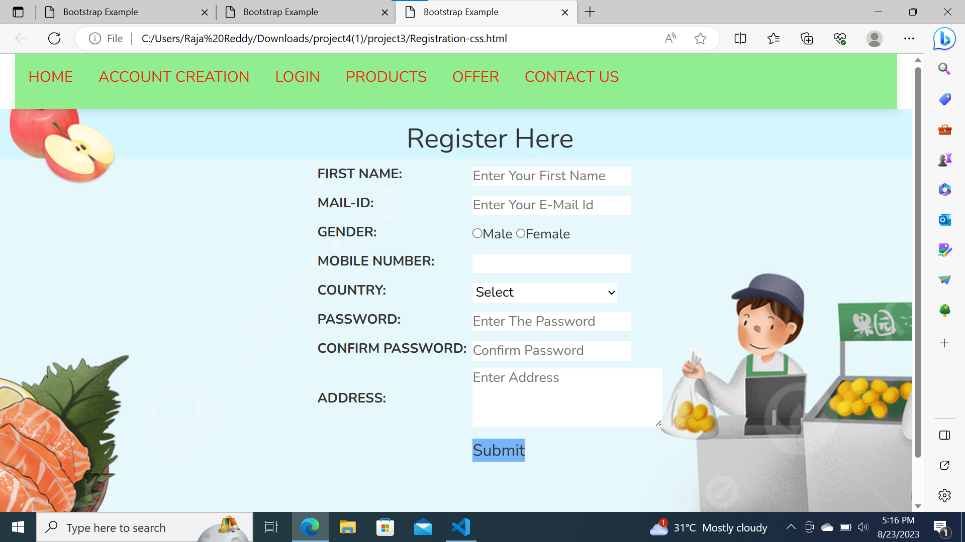

Slide 19
Login page code & output

Slide 20
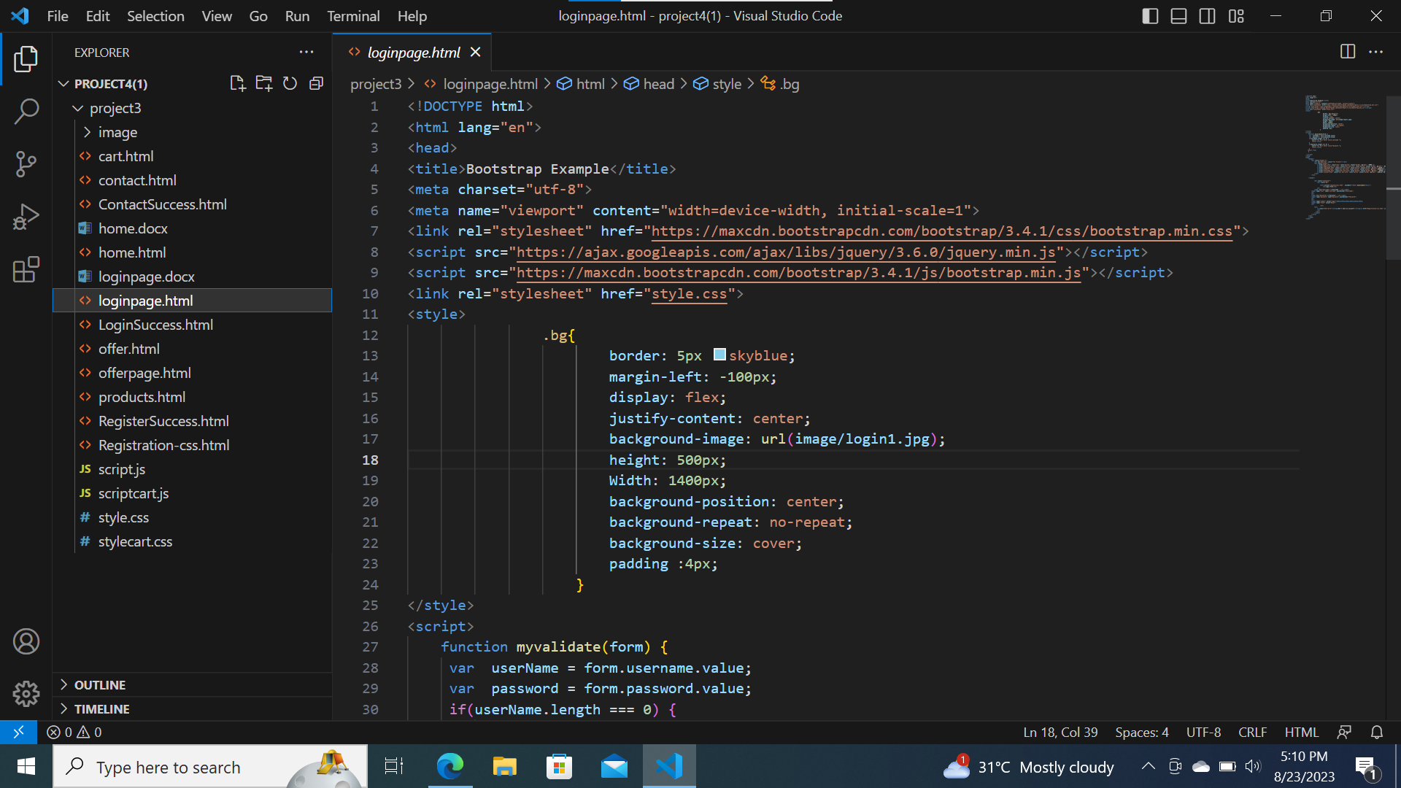

Slide 21
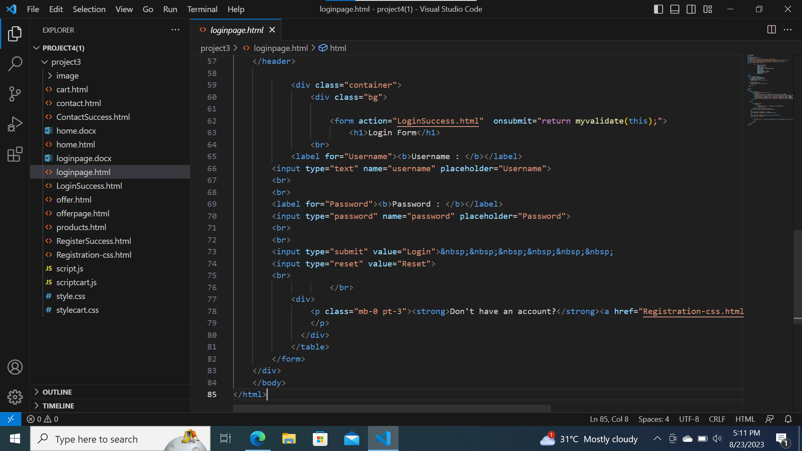

Slide 22
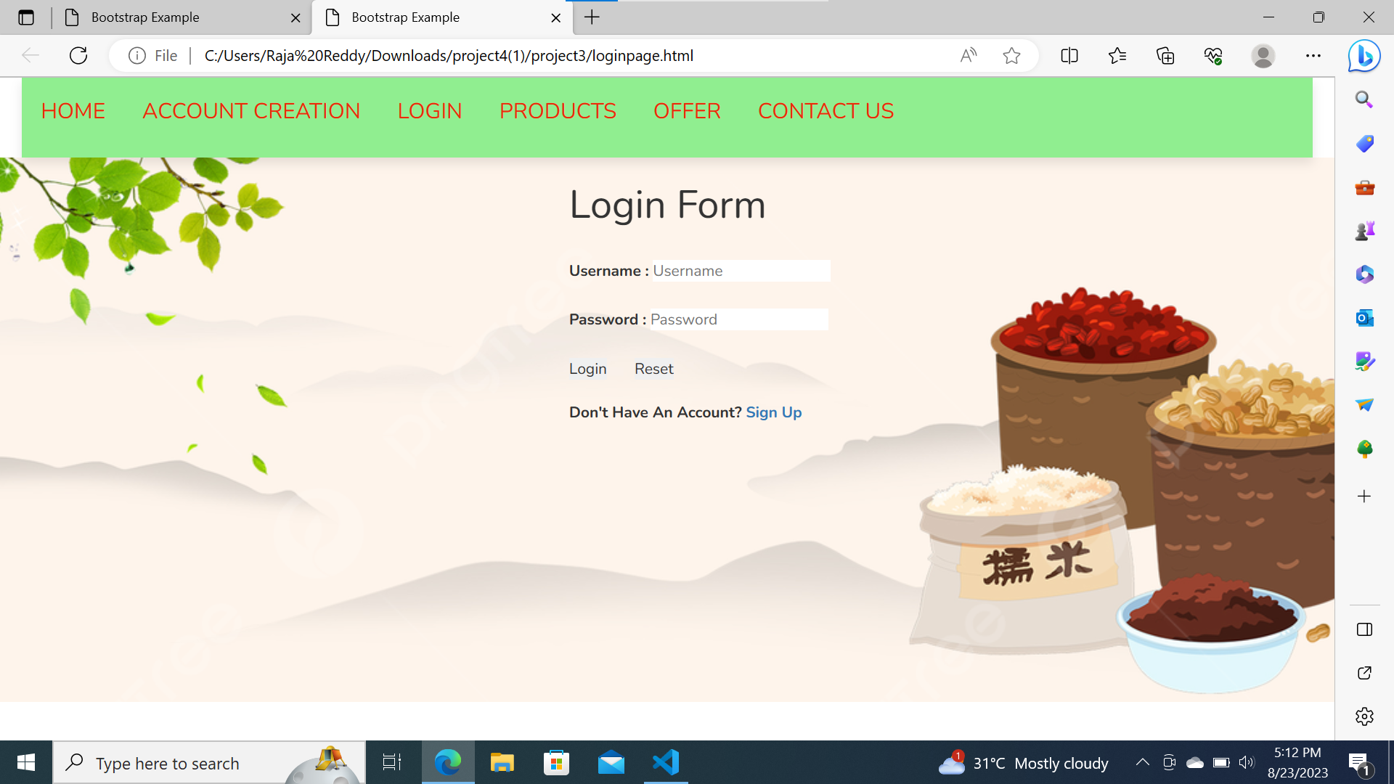

Slide 23
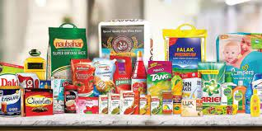
Products Page Code & Output

Slide 24
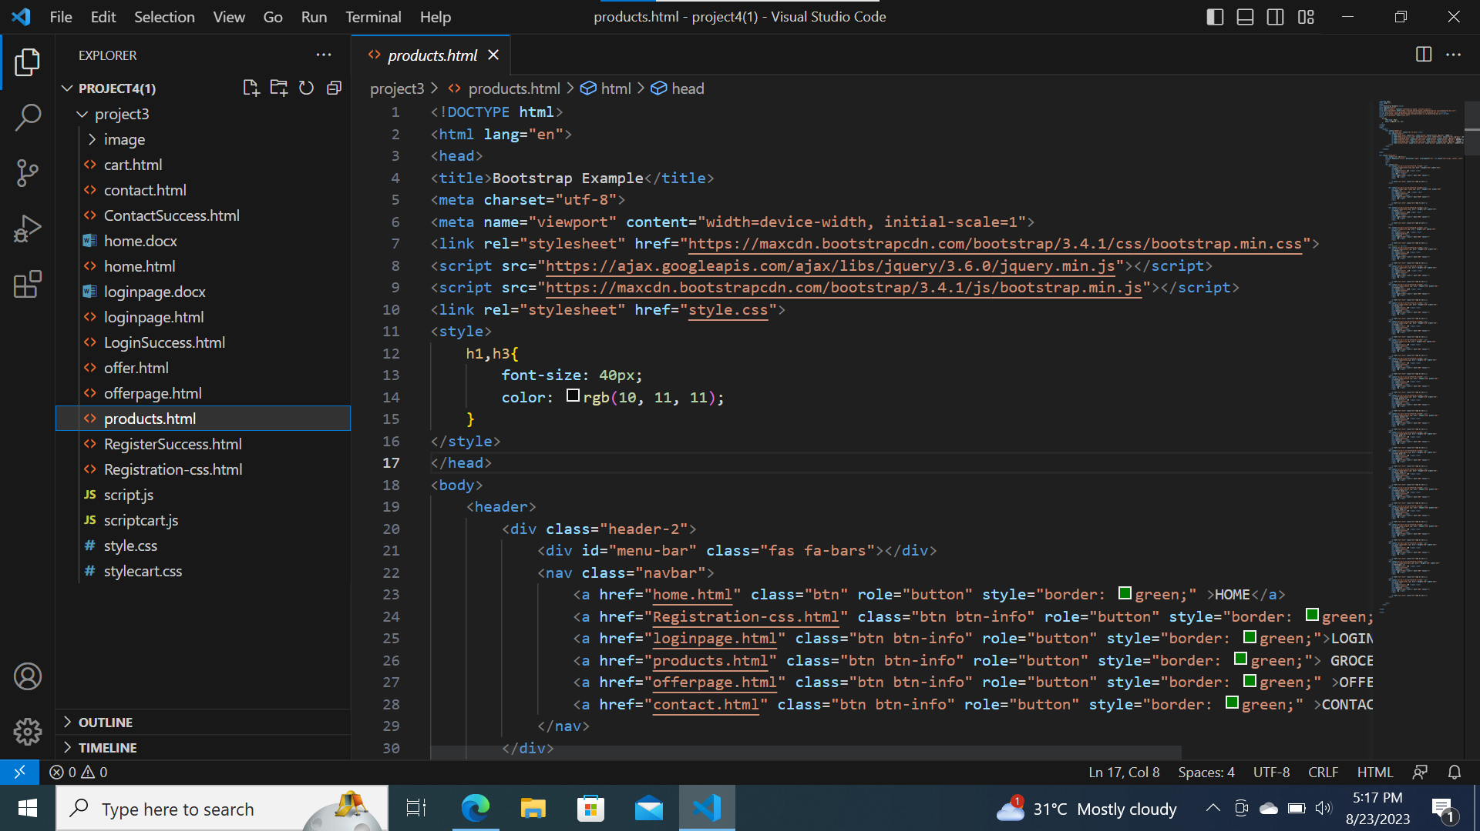

Slide 25
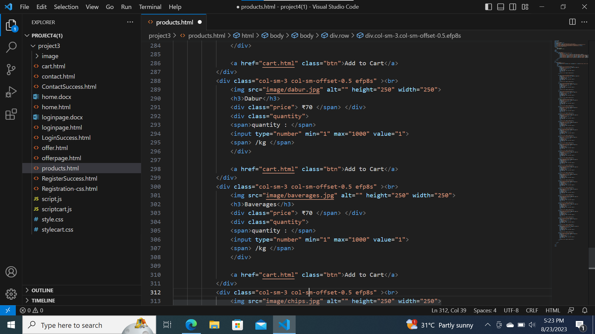

Slide 26
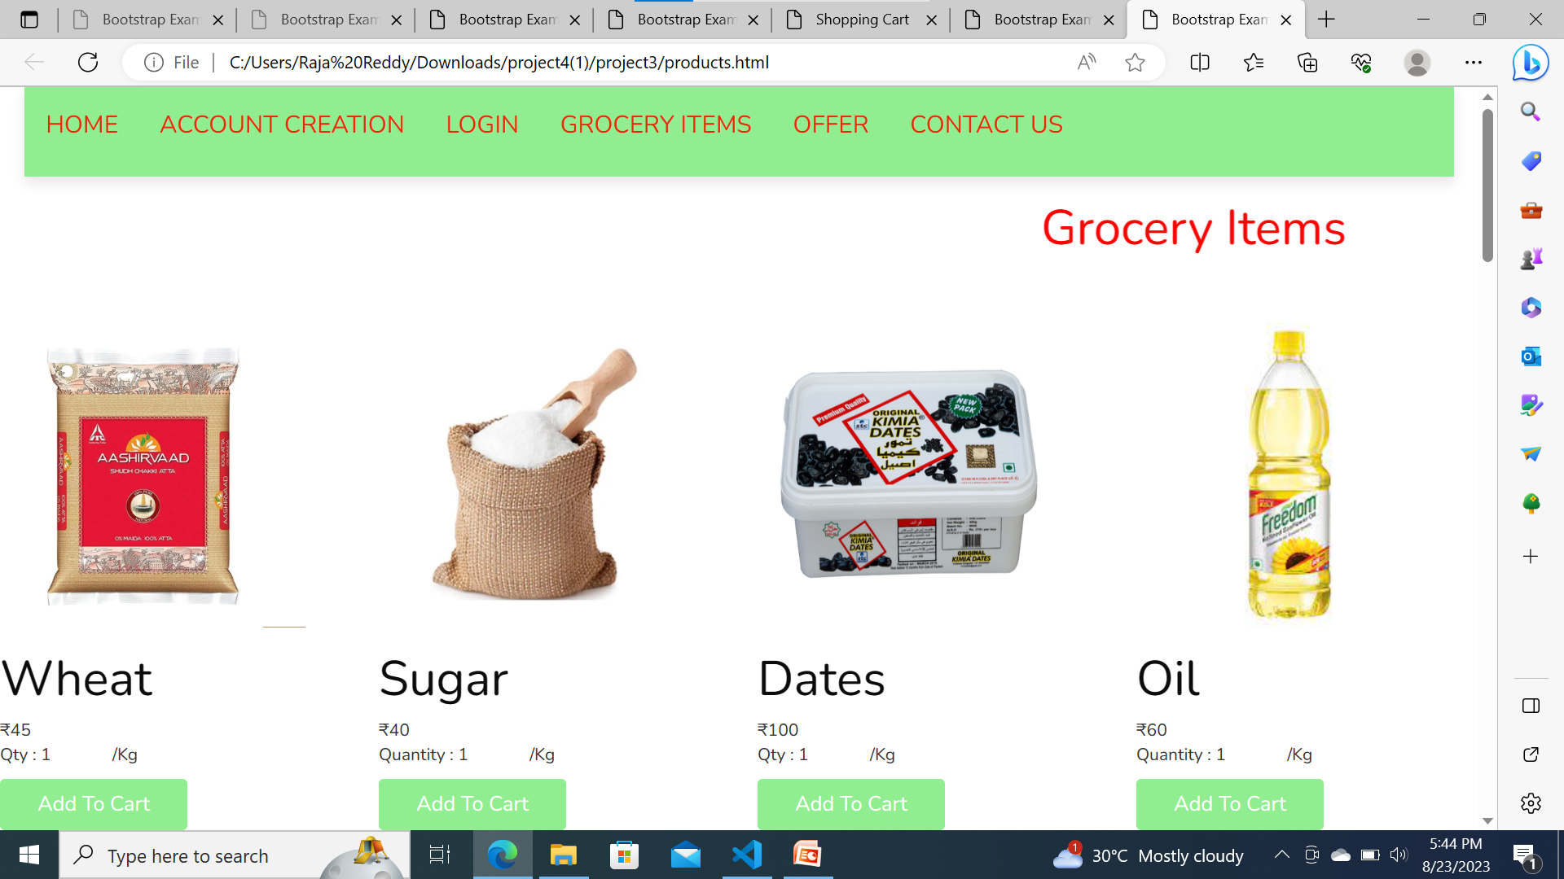

Slide 27
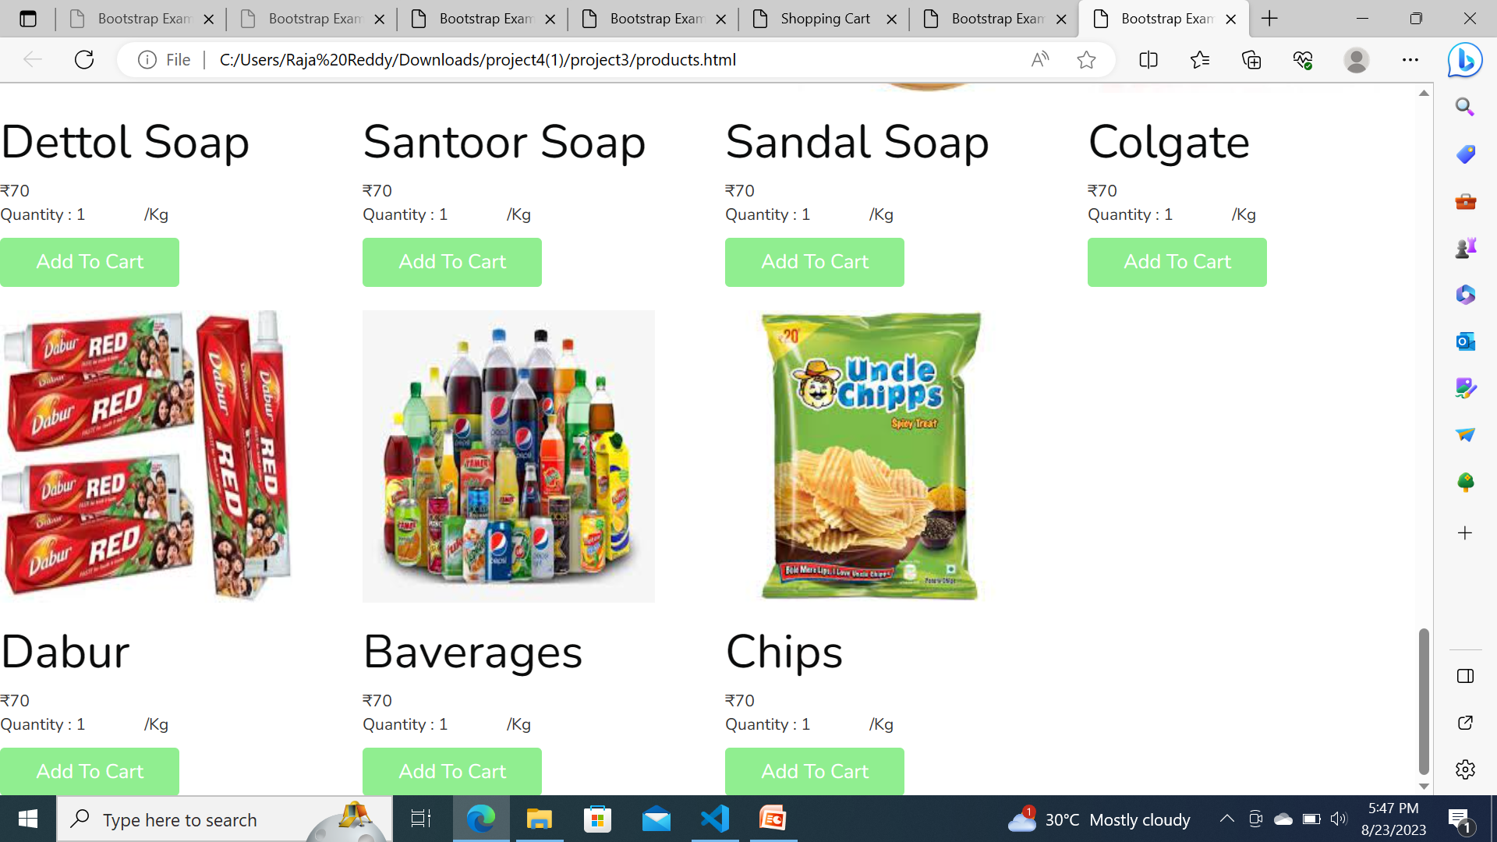

Slide 28

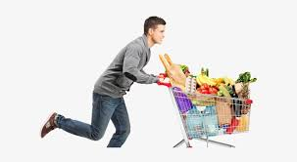
Cart page code & output

Slide 29
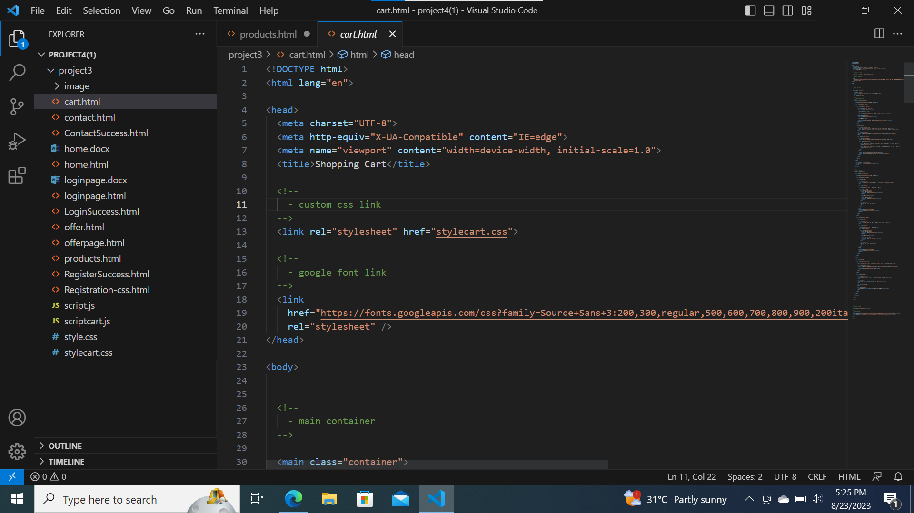

Slide 30
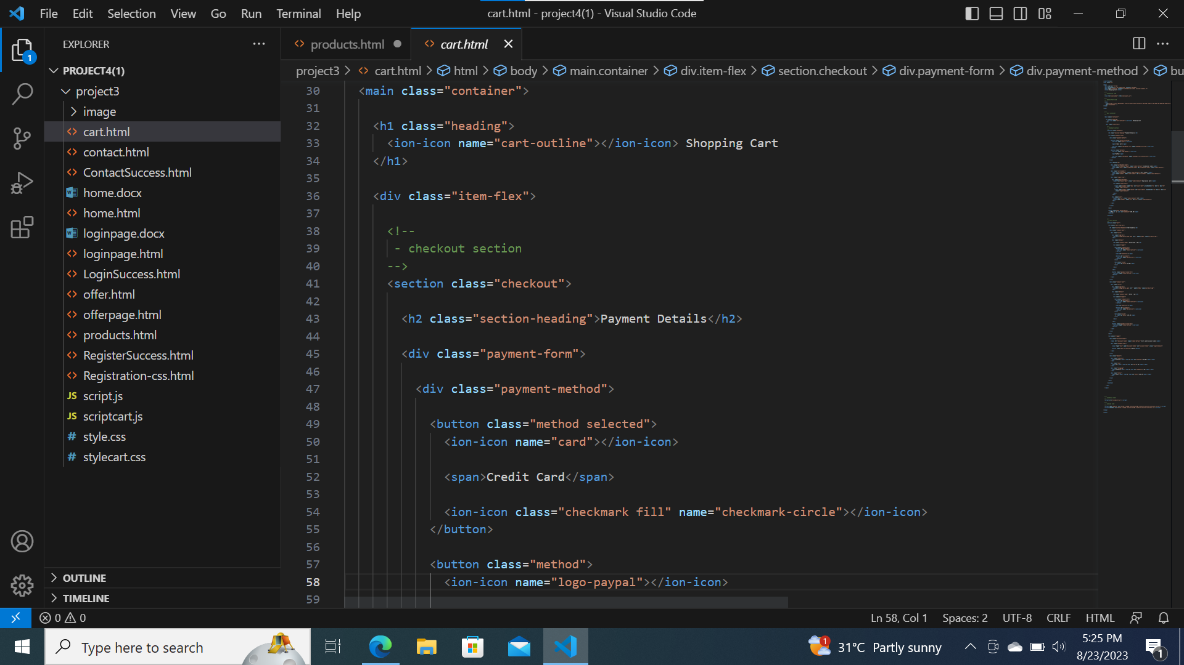

Slide 31
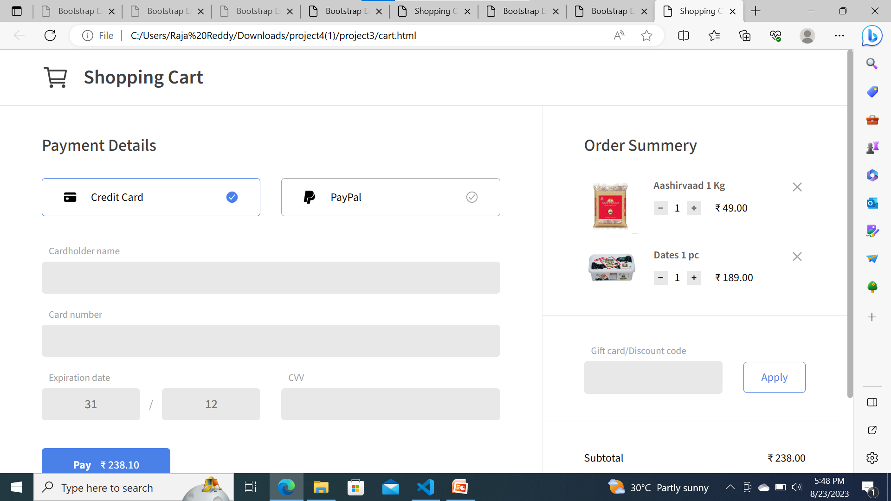

Slide 32
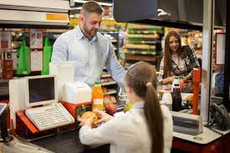
Contact page code & output

Slide 33
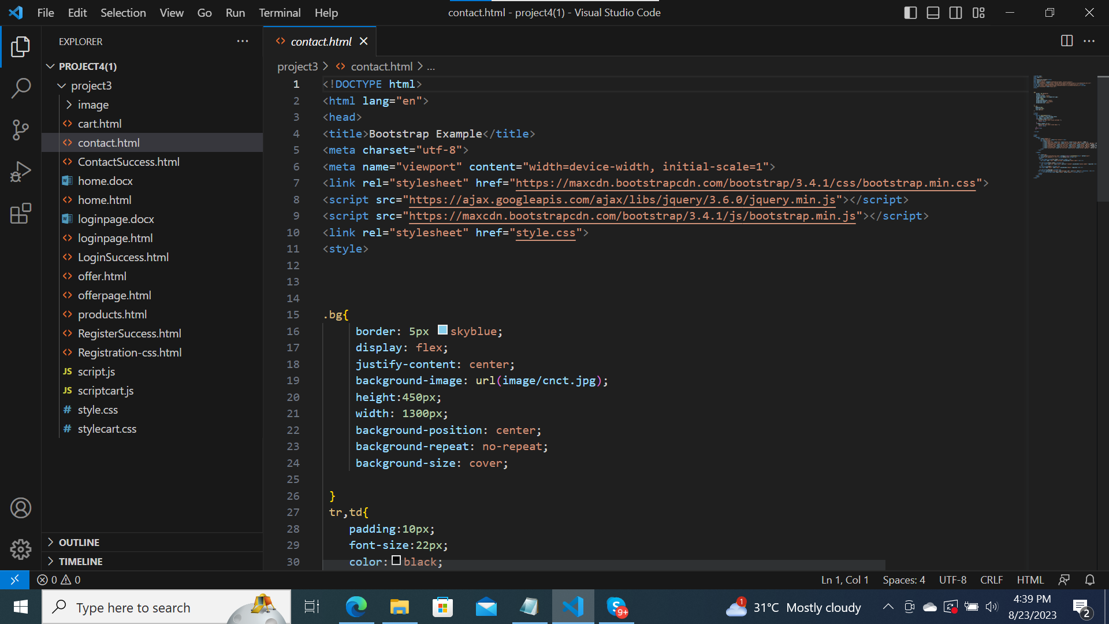

Slide 34
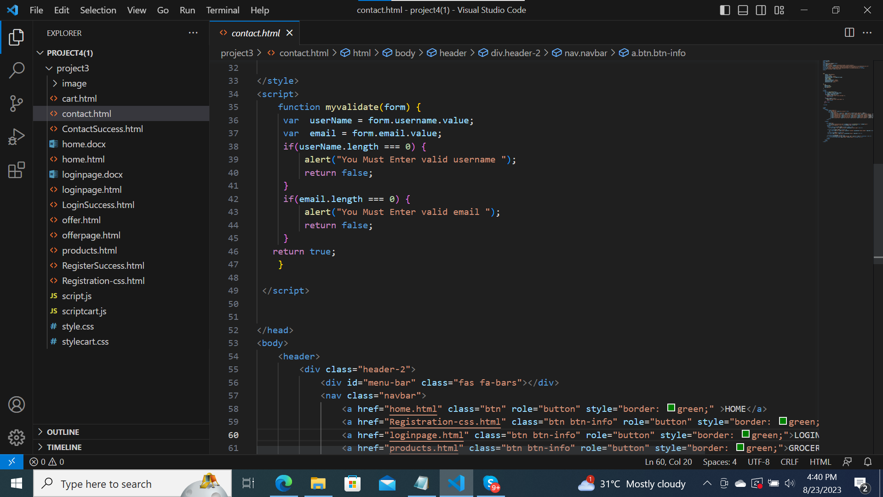

Slide 35
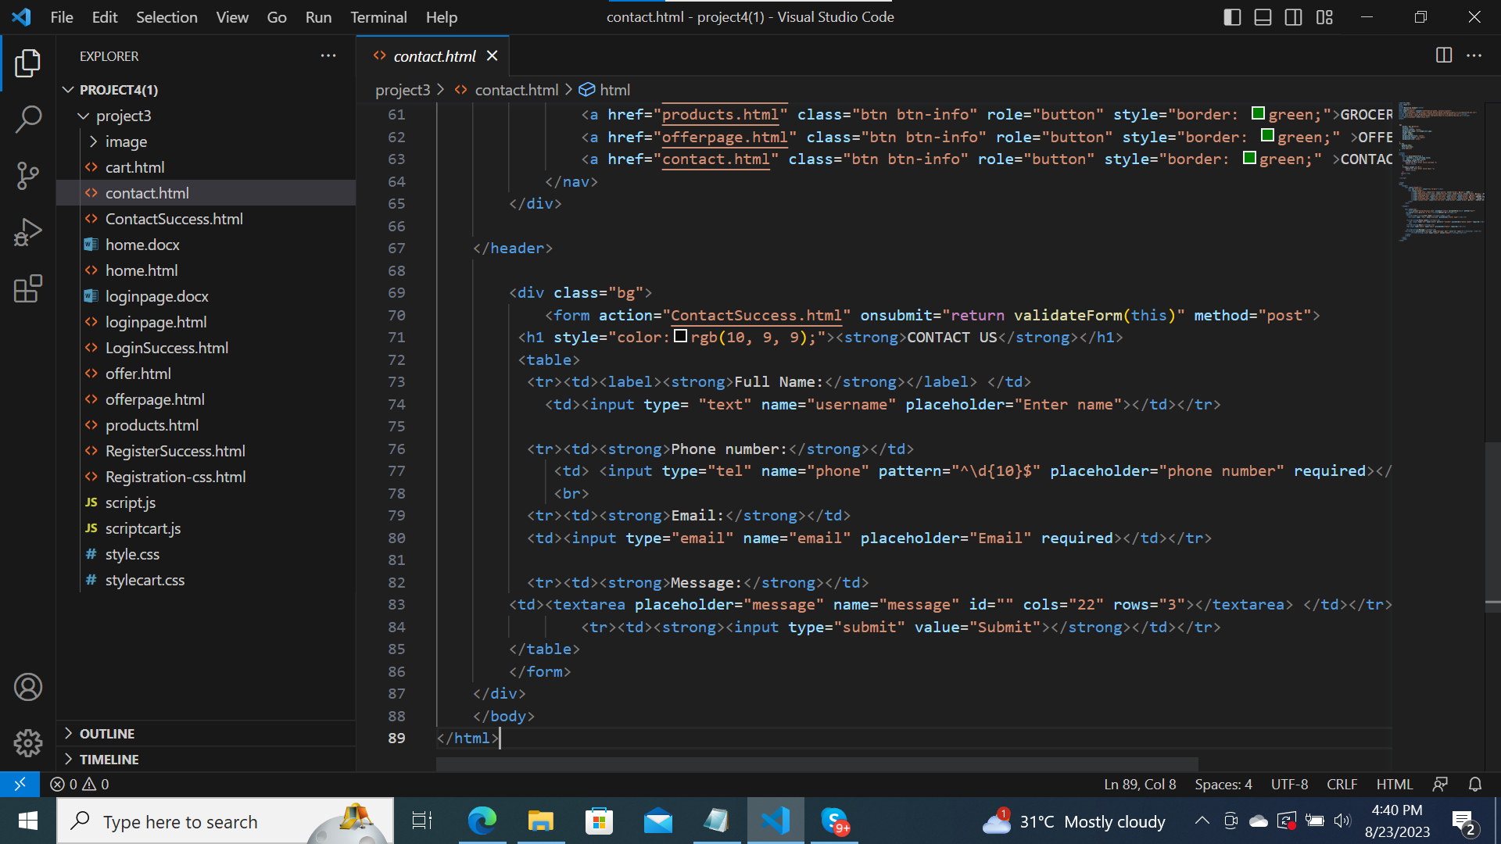

Slide 36
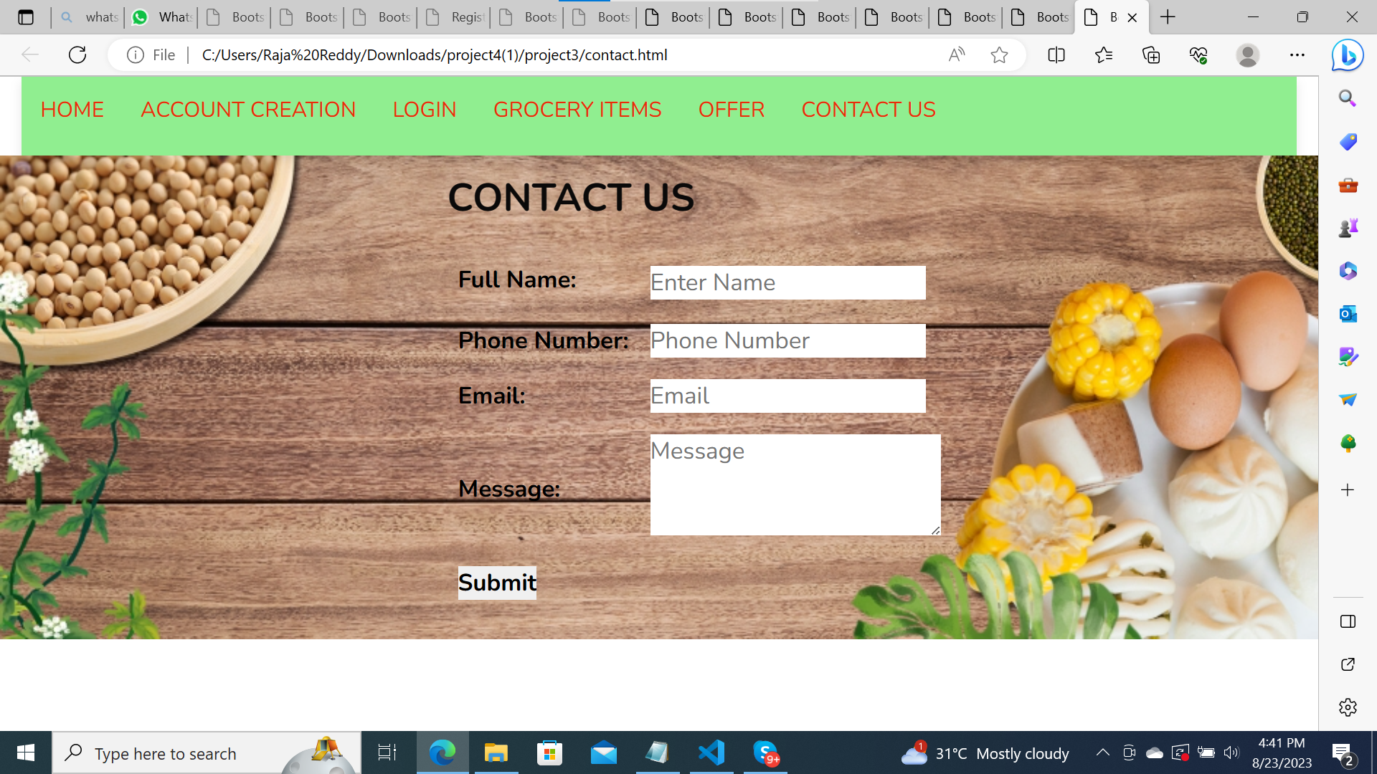

Slide 37

Offers page code & output

Slide 38
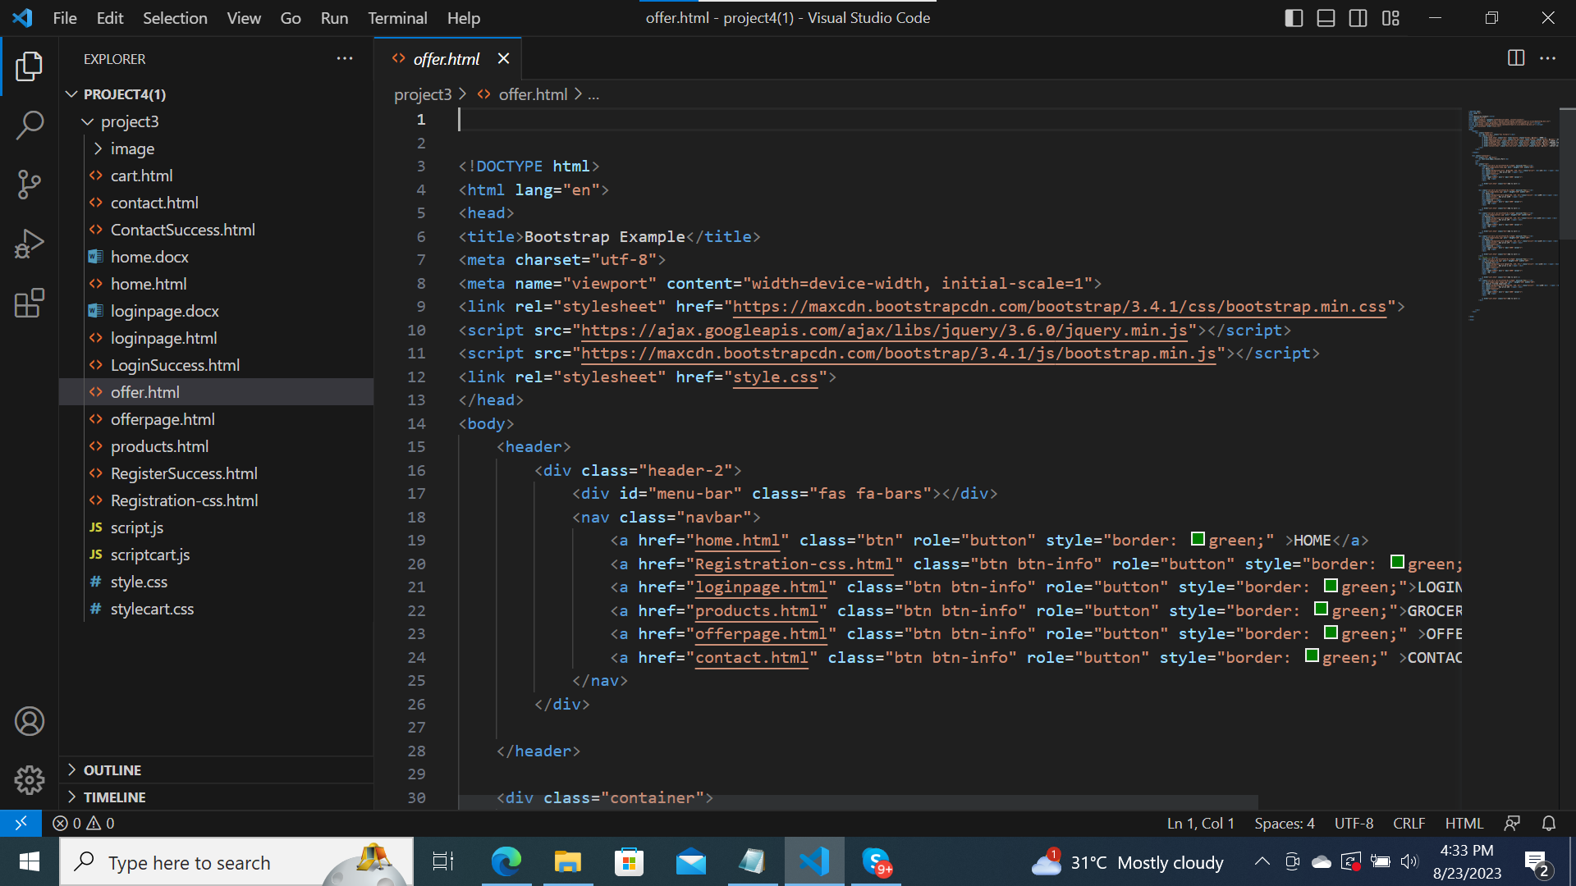

Slide 39
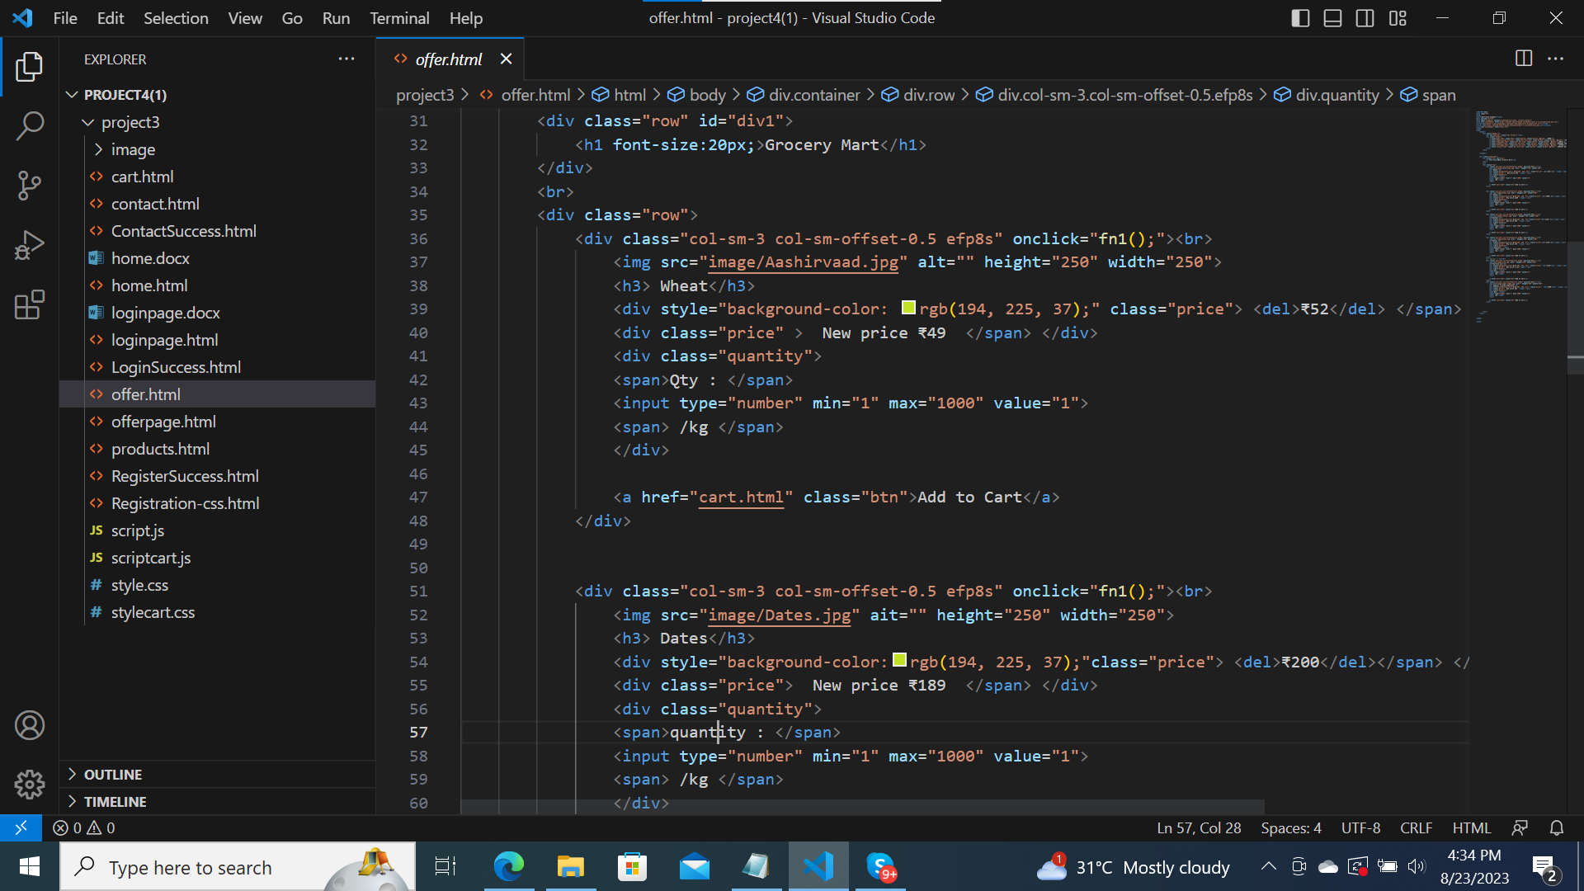

Slide 40
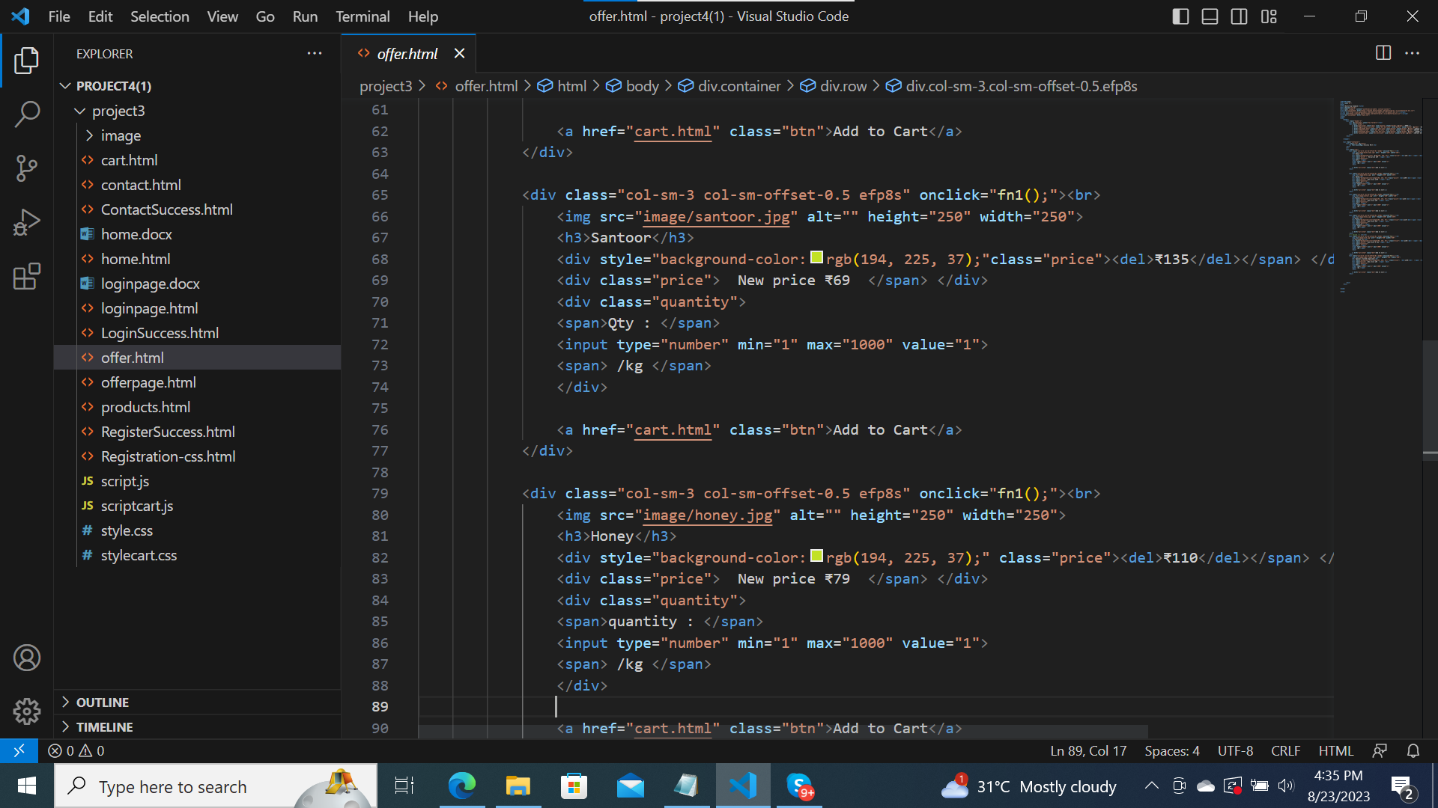

Slide 41
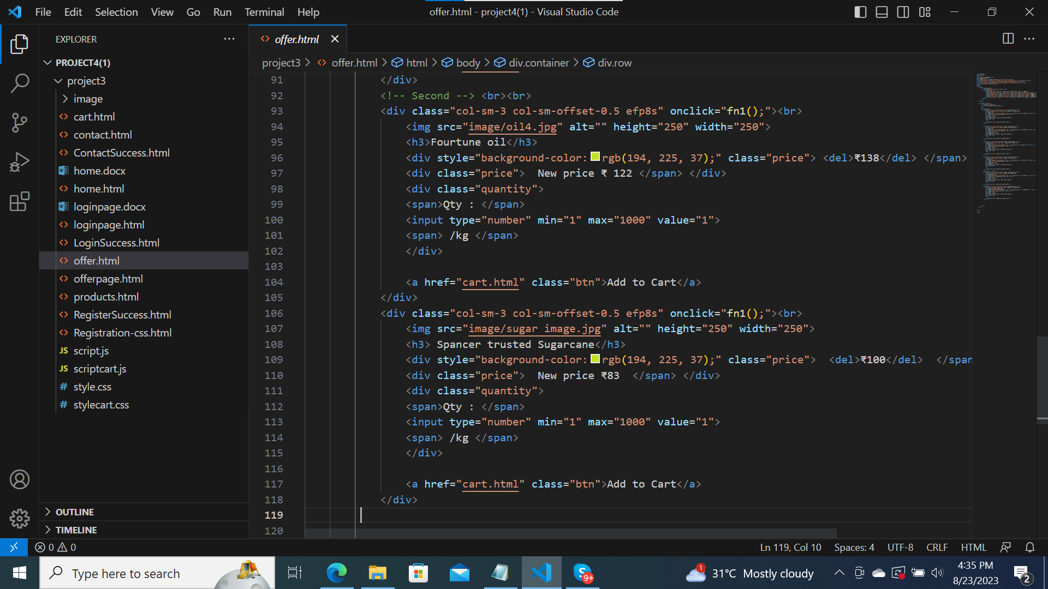

Slide 42
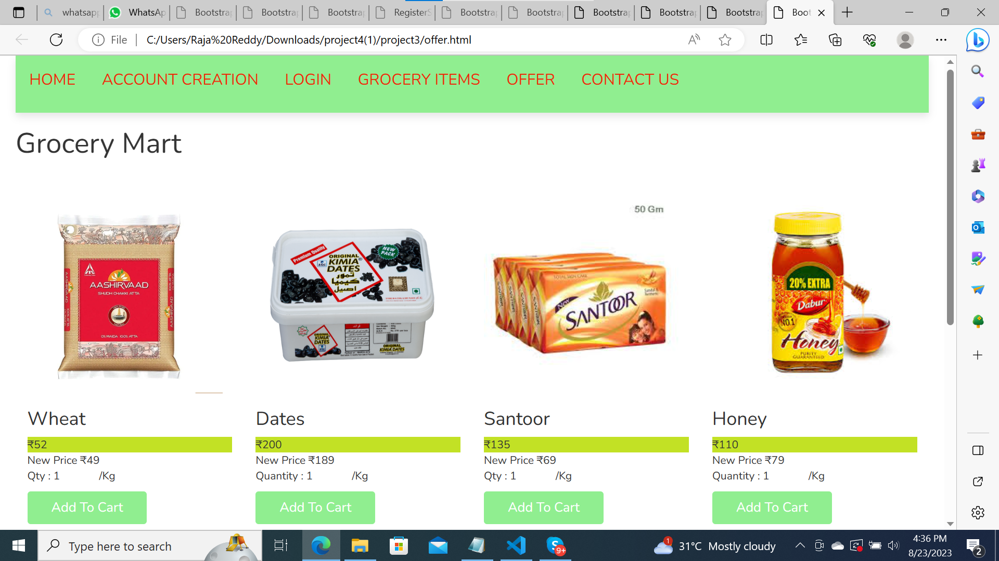
Output:

Slide 43
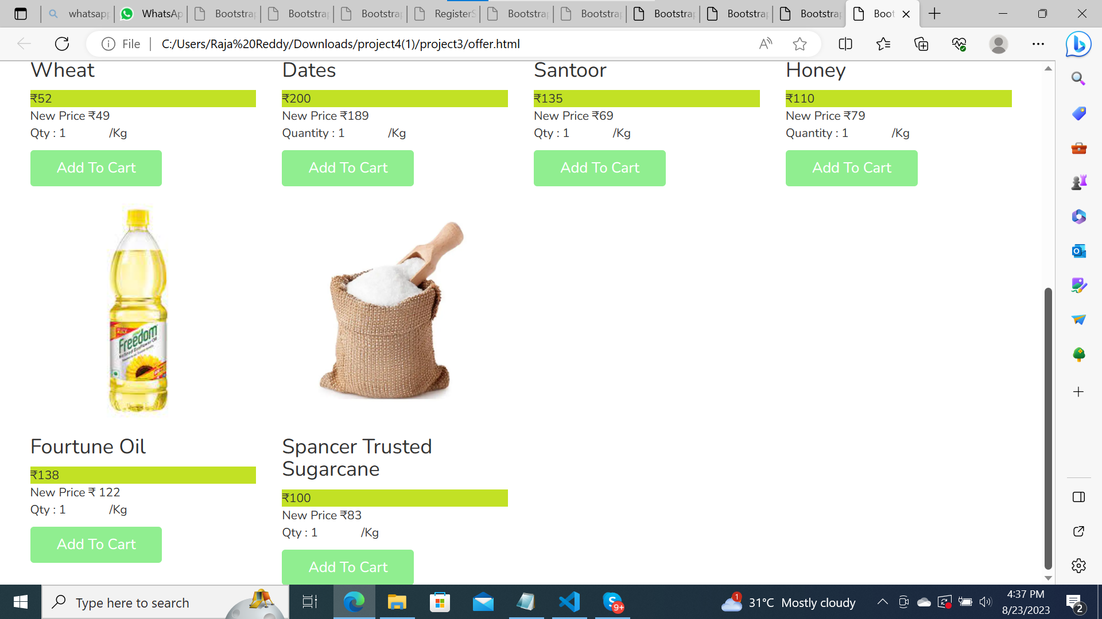

Slide 44
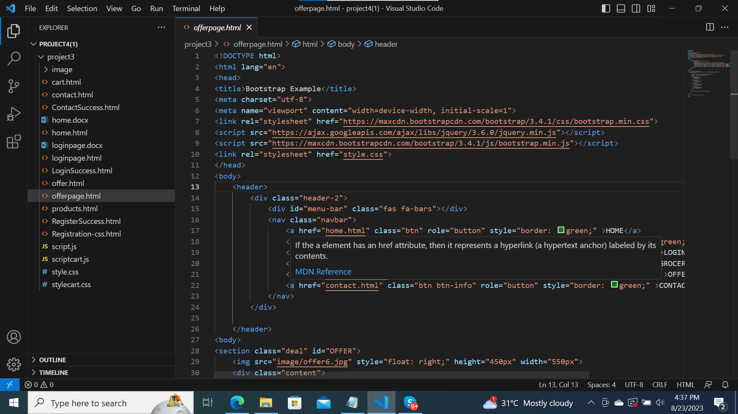

Slide 45
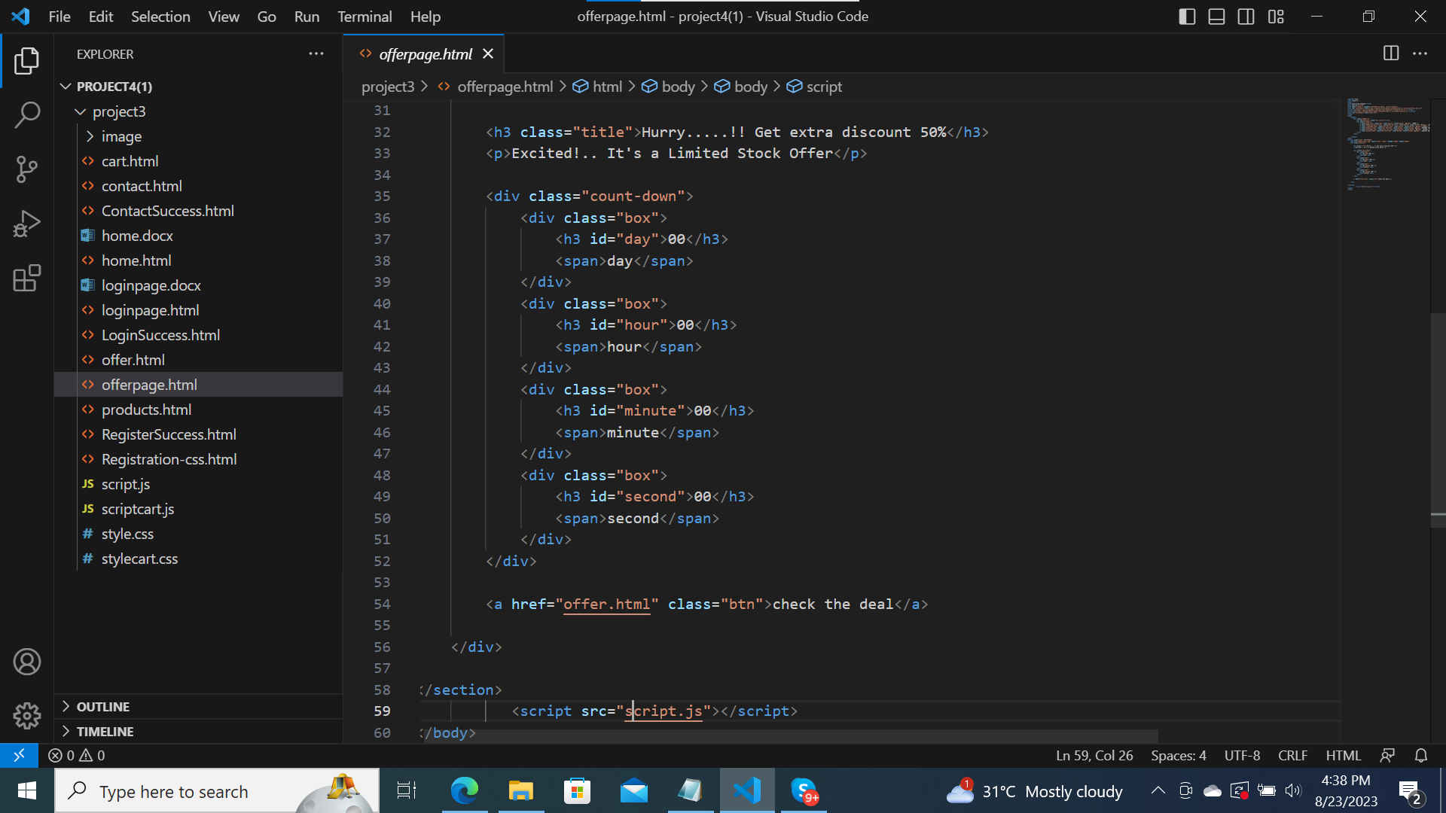

Slide 46
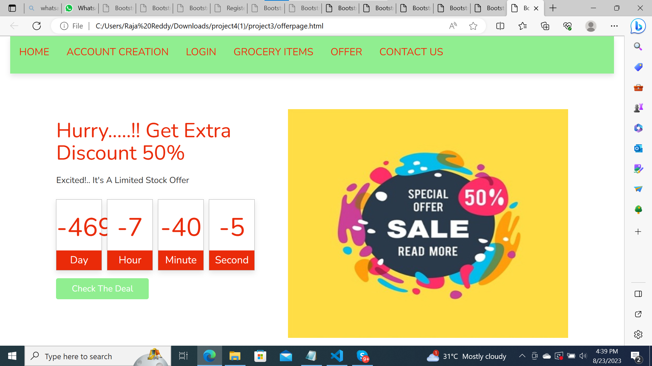

Slide 47


